Slide 1
My YouTube App
By:
Mallika Palreddy
Prashanth Venna
Mehaboob Gori
Venkata Purnesh Gaddam

Slide 2
We selected usecase given by Adknowledge , to develop an application using YouTube V3 API.
We used Eclipse tool with Java and Advanced Rest Client Services using Jersey framework.
We developed all the features mentioned by them,
login page with forgot password, remember me and log off feature
A dashboard and a search for a video option

Slide 3
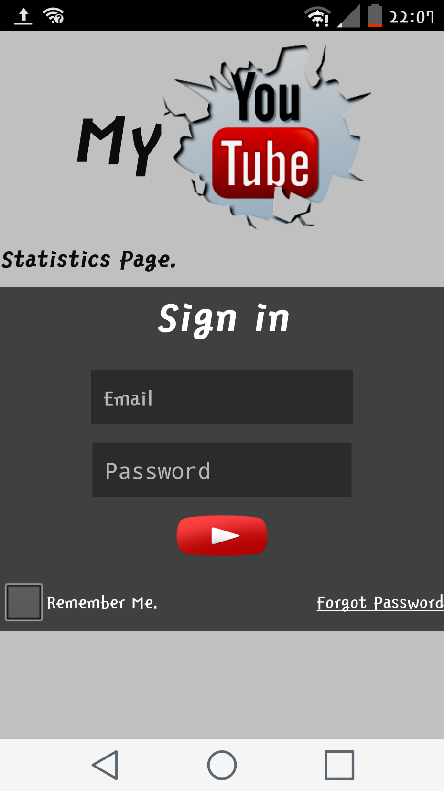
This is the main page of our app with login , remember me and forgot password features.

Slide 4
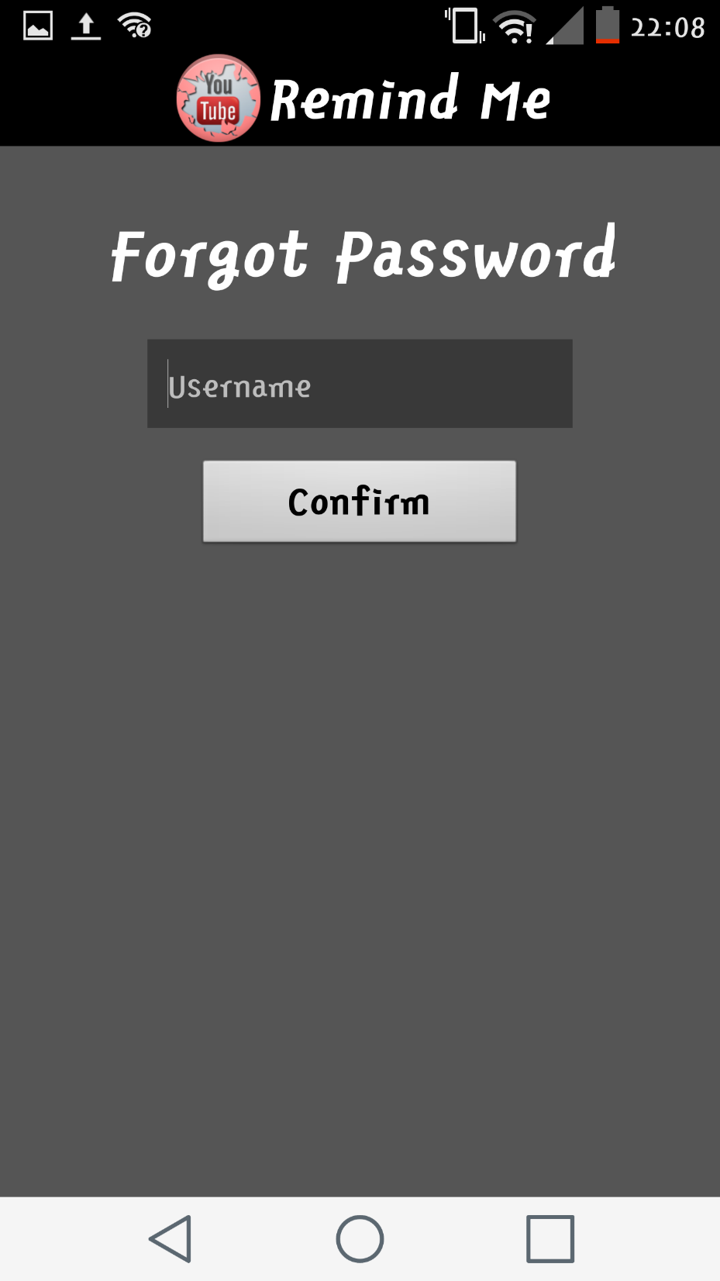
If the user forgets the password, he can click on the forgot password from the above slide to enter to this page.
Where he is prompted to enter his email(username) and click confirm to get a mail with option to enter new password.

Slide 5
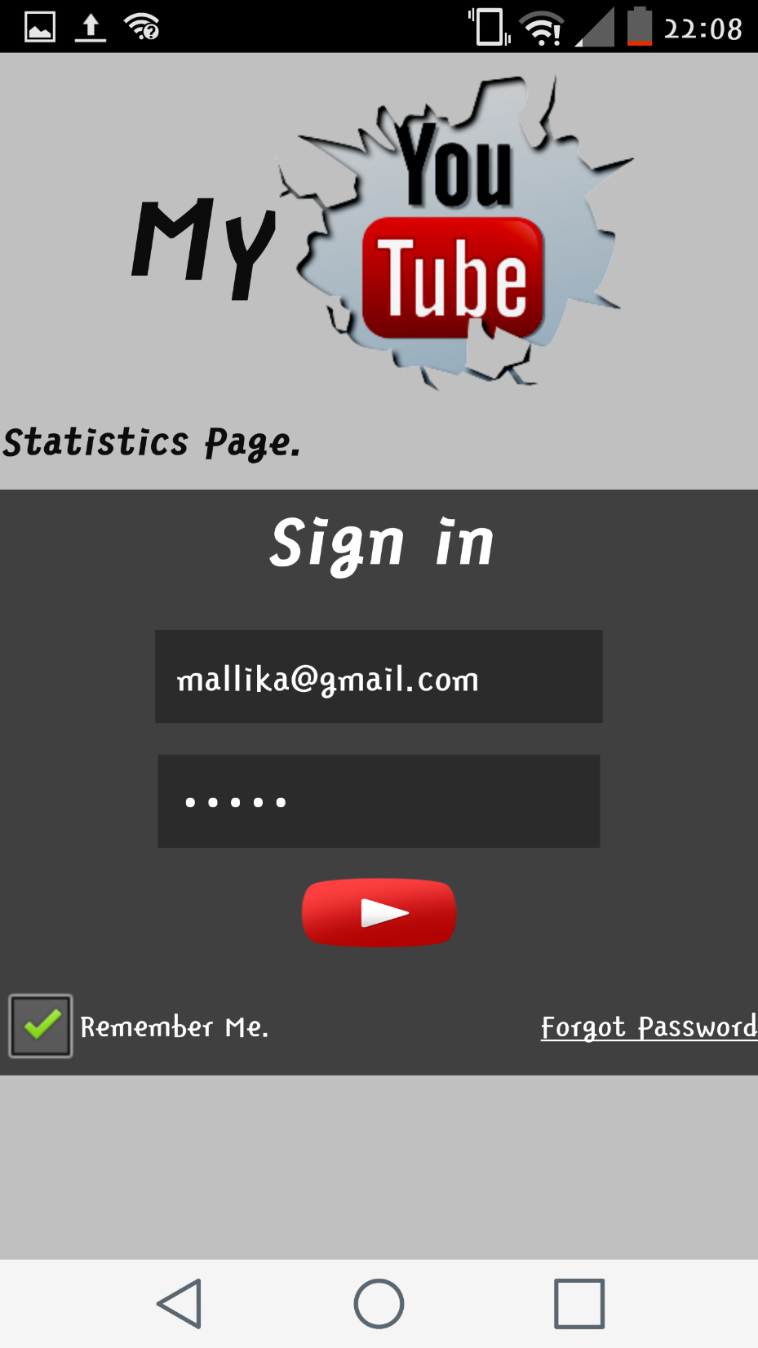
After entering the details to login and if the user checks the remember me button, the app saves his login details.
If the user clicks the login button, he enters into a page shown in the below slide

Slide 6
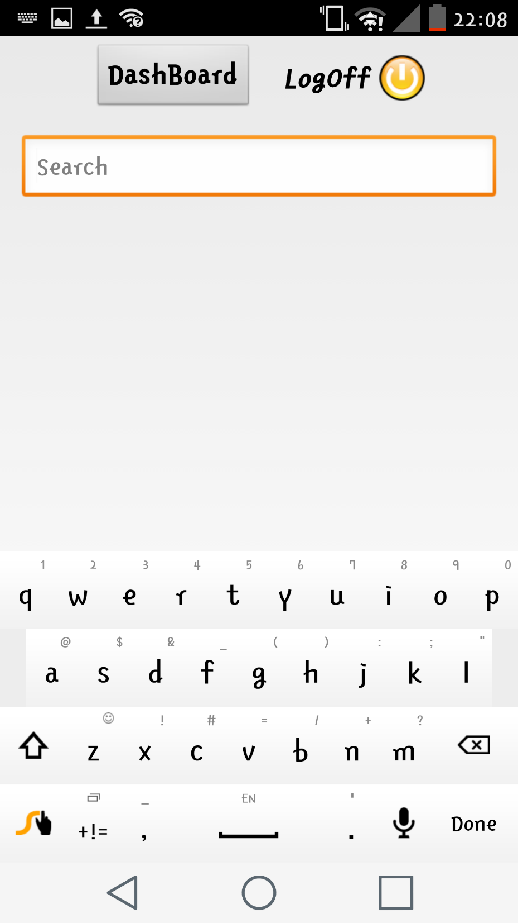
In this page the user can enter the video name he wants to search or click on Dashboard button to get his viewed videos.
He also has the option to log off

Slide 7
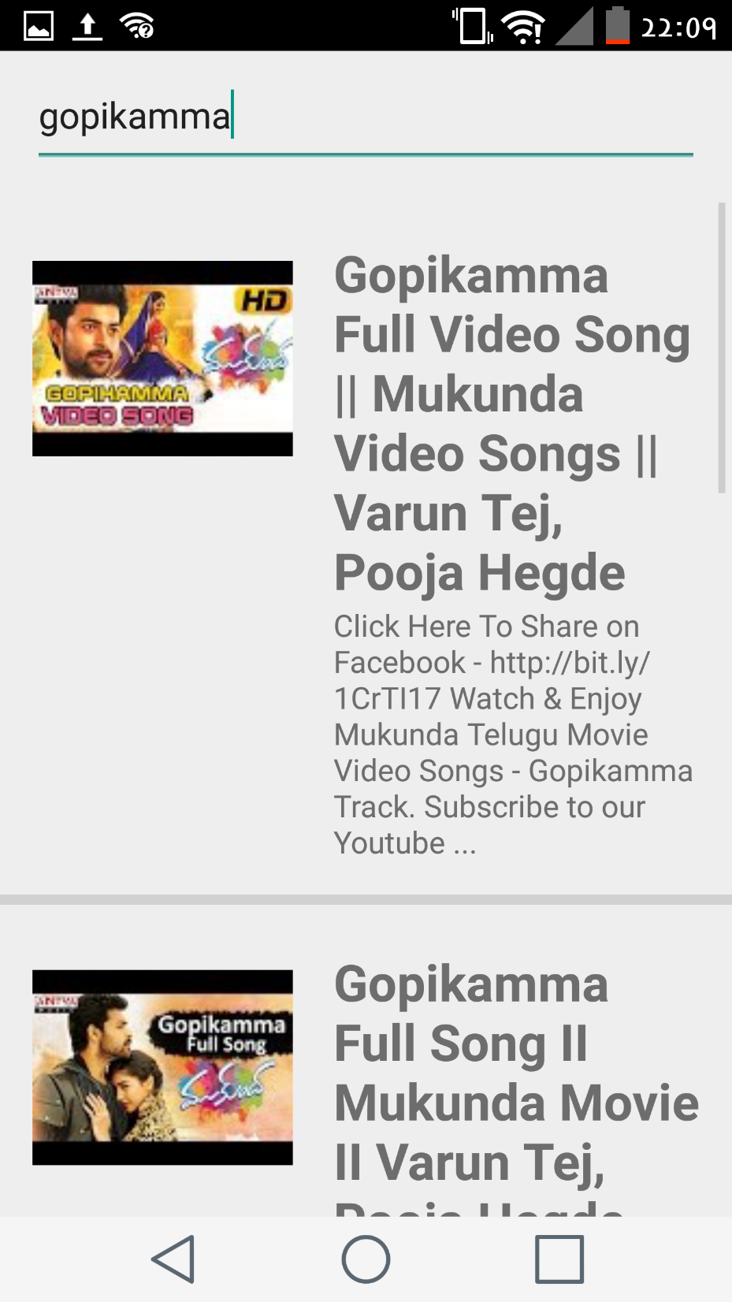
The image shown depicts the output when we enter “gopikamma” as a keyword in the search box.

